Slide 1
CONSERVATION OF NATURAL RESOURCES BCV755B
Module-1

Slide 2
CONSERVATION OF NATURAL RESOURCES BCV755B –Syllabus
Land: Land as a resource, types of lands, conservation of land forms, deforestation, effect of land use changes.
Soil health, ecological and economic importance of soil, impact of soil degradation on agriculture and food security, need for soil conservation, sustainable land use planning.

Slide 3
Natural resources: - Natural resources are materials from the Earth that are used to support life and meet people's needs. Any natural substance that humans use can be considered a natural resource. Oil, coal, natural gas, metals, stone and sand are natural resources. Other natural resources are air, sunlight, soil and water.
Natural resources can be part of our natural heritage or protected in nature reserves. Particular areas often feature biodiversity and geodiversity in their ecosystems.
Natural resources may be classified in different ways. Natural resources are materials and components (something that can be used) that can be found within the environment.
Every man-made product is composed of natural resources (at its fundamental level).

Slide 4
Conservation of Land Resource
Growing population and their ever growing demand has led to a large scale destruction of forest cover and arable land and has created a fear of losing this natural resource.
Therefore, the present rate of degradation of land must be checked. Afforestation, land reclamation, regulated use of chemical pesticide and fertilisers and checks on overgrazing are some of the common methods used to conserve land resources.

Slide 5
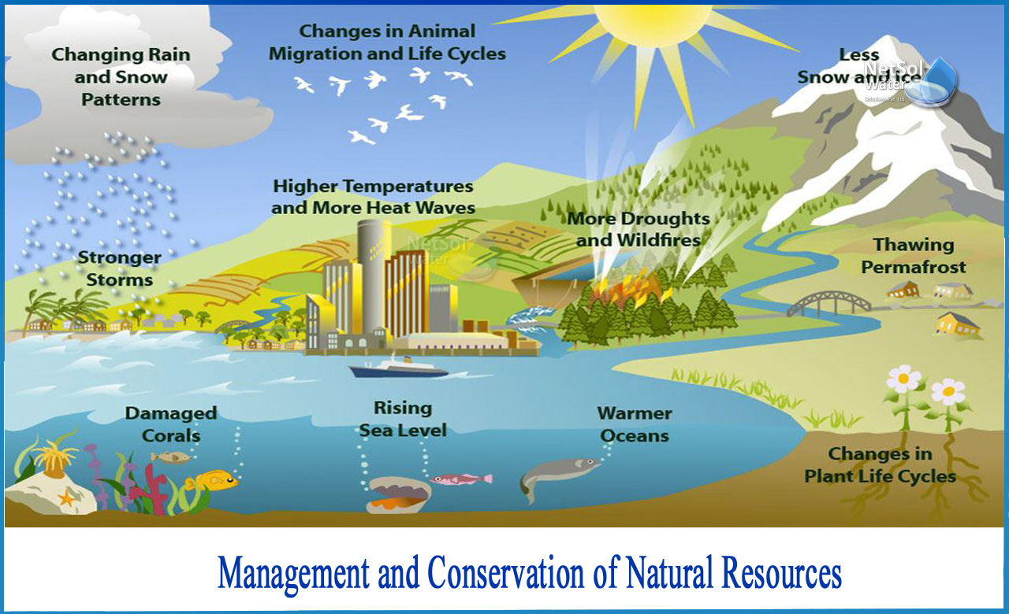
Definition: Conservation of land resources is the sustainable use and management of land resources.
It includes the conservation of soil, water, plants, and animals. Conservation of land resources helps to protect the environment and to ensure that there is enough food and water for future generations.

Slide 6
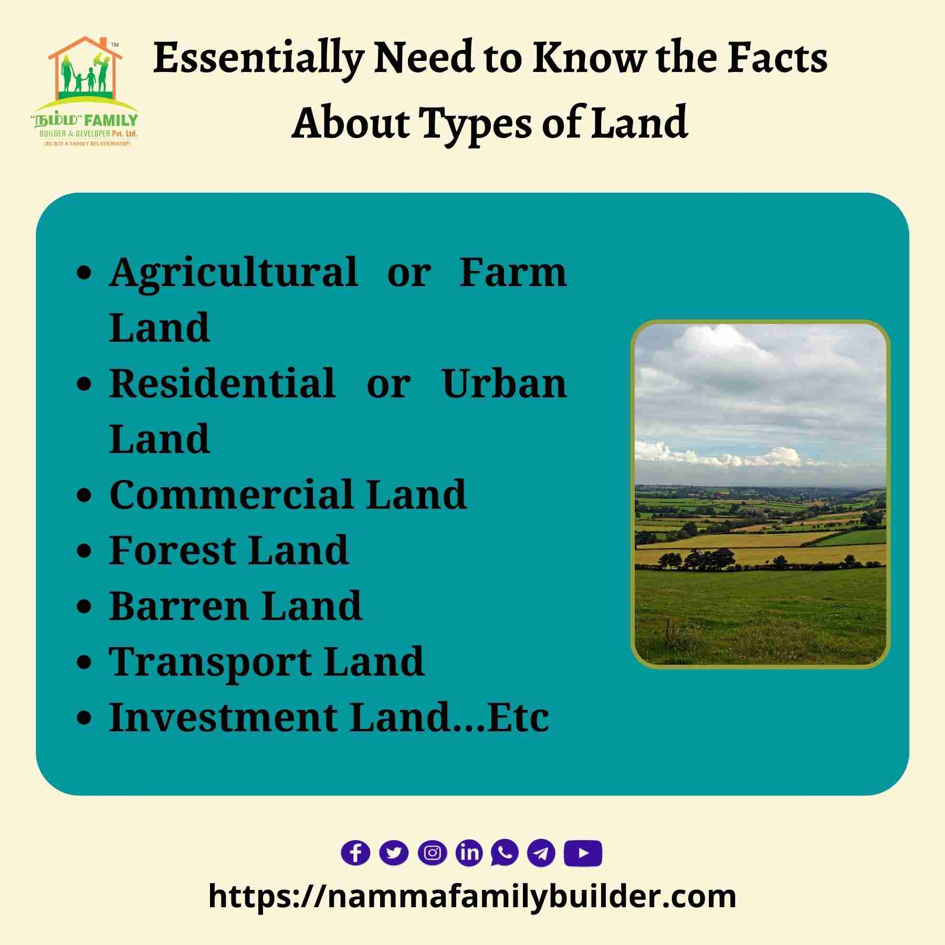
Types of lands
Agricultural Land
Used for farming and cultivation of crops.
Includes:
  Arable land (for plowing and planting)
  Pastures (for grazing animals)
  Orchards and vineyards.
Agricultural land is defined as the land area that is either arable, under permanent crops, or under permanent pastures.
Non-agricultural land is dedicated to residential, commercial, industrial and non-farming activities. The land use is mainly for residential buildings, commercial complexes, industrial estates, and infrastructure such as roads, railways, and public utilities.

Slide 7
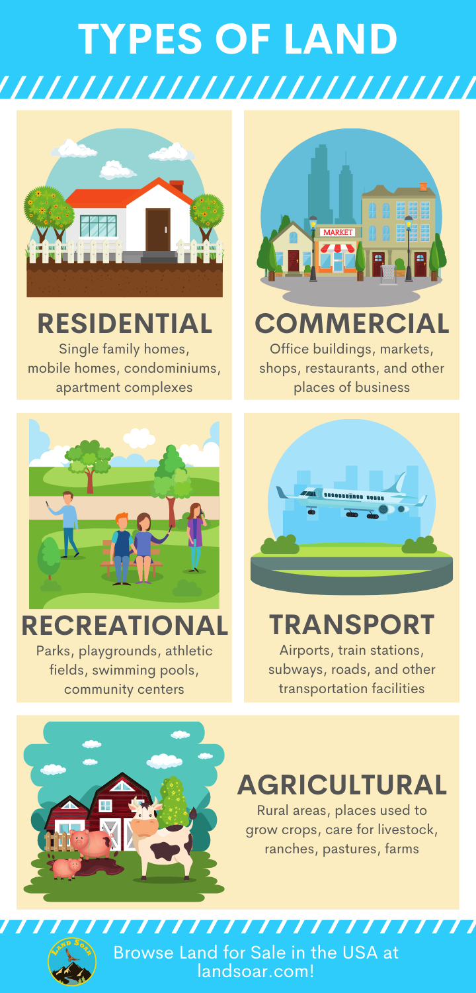
Residential Land
Land designated for housing and human settlement.
Includes:
  Urban plots
  Suburban neighborhoods
  Rural homesteads
Commercial Land
Used for business and commercial purposes.
Examples:
  Retail stores
  Office buildings
  Shopping malls

Slide 8
Industrial Land
Used for factories, warehouses, and production facilities.
Often located outside residential areas due to noise or pollution concerns.
Forest Land
Covered with trees and vegetation.
Important for:
  Timber production
  Wildlife habitat
  Climate regulation

Slide 9
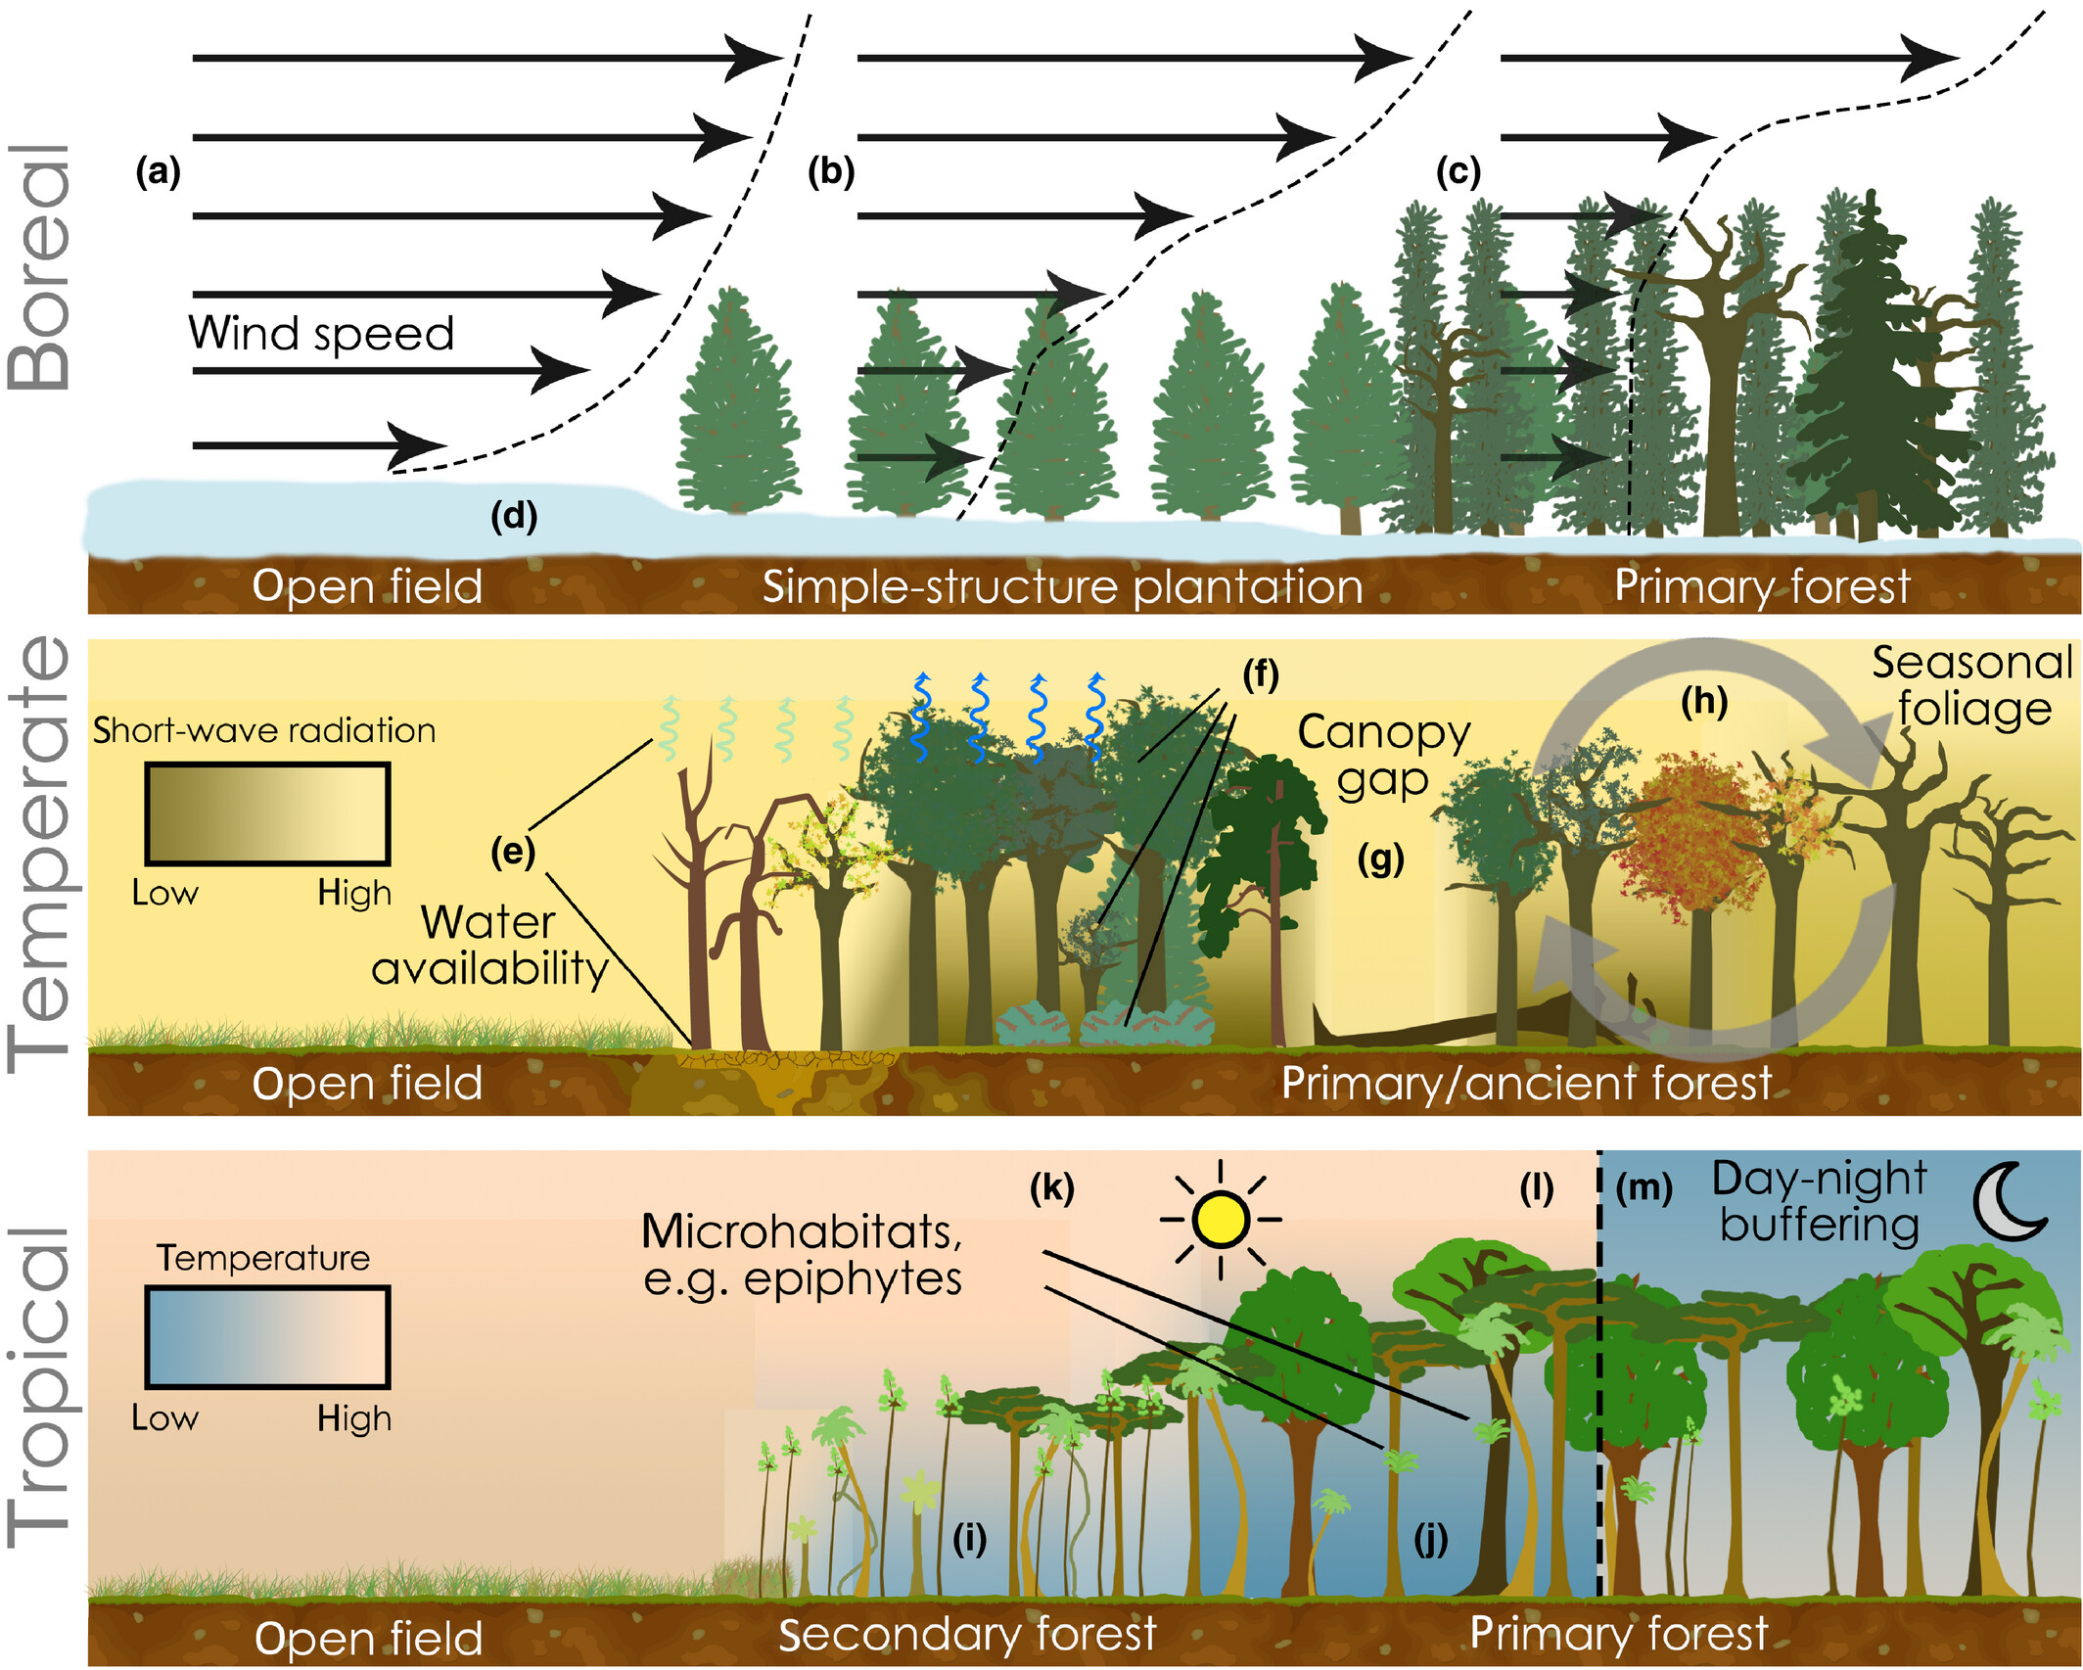

Slide 10
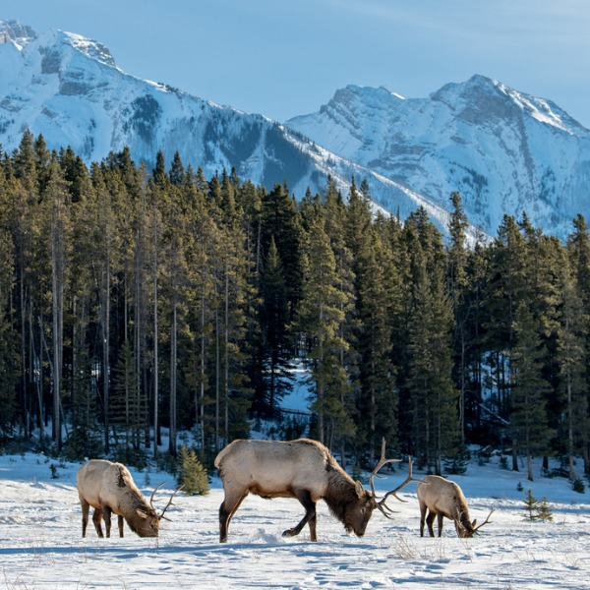
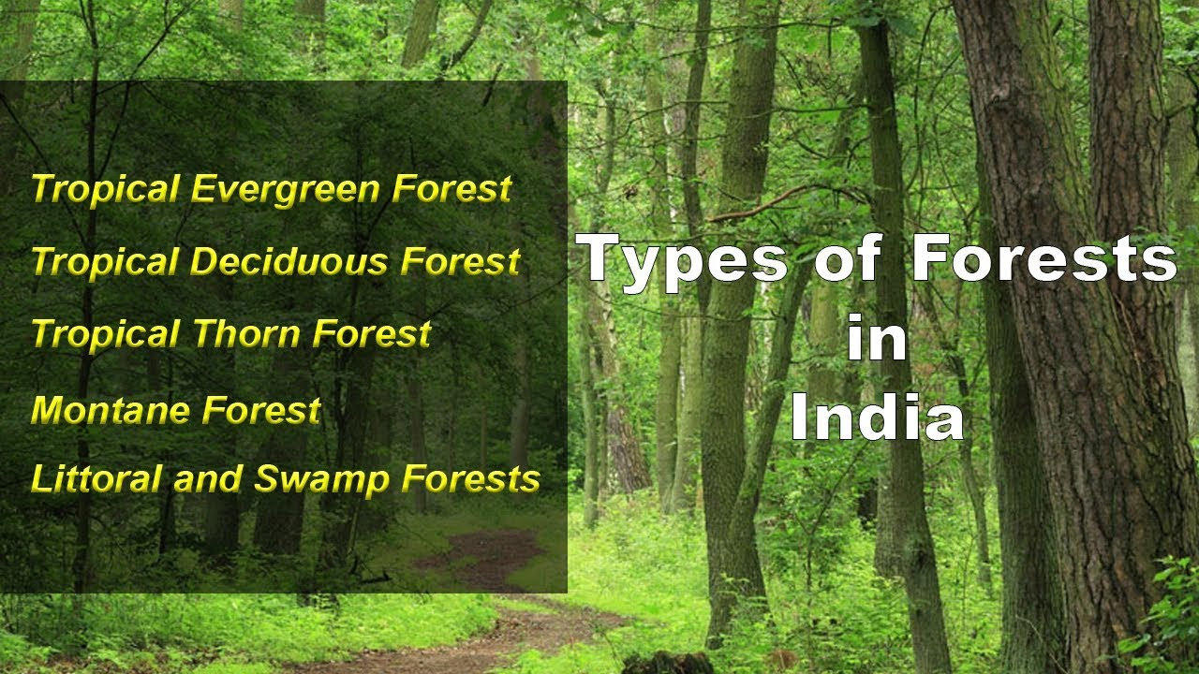
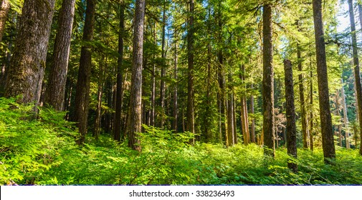
Types of forests
Tropical forests
Temperature forests
Boreal forests
Boreal forests
Tropical forests
Temperature forests

Slide 11
Recreational Land
Set aside for leisure and public use.
Includes:
Parks
Sports fields
Nature reserves
Desert and Barren Land
Land with little or no vegetation.
Includes:
  Deserts
  Rocky areas
  Land not suitable for cultivation
Mining and Resource Land
Land used for extracting natural resources.
Examples:
Coal mines
Oil fields
Quarries

Slide 12
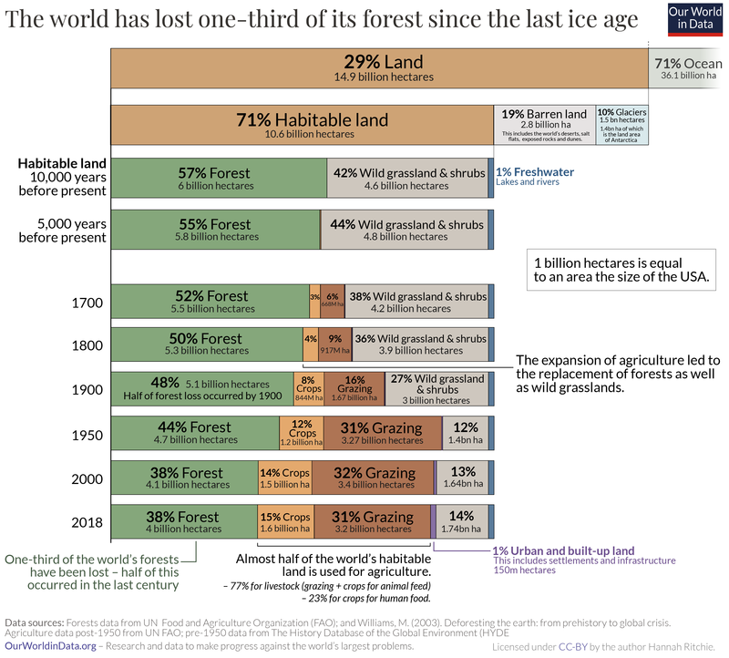

Slide 13
CONSERVATION OF LAND FORMS
Conservation of landforms refers to the protection and sustainable management of natural physical features of the Earth, such as mountains, valleys, plateaus, hills, deserts, and coastal areas, to prevent degradation, preserve ecosystems, and maintain natural beauty.
Why Conservation of Landforms Is Important:
Prevents erosion and degradation
Protects biodiversity and habitats
Preserves natural beauty and cultural heritage
Supports sustainable tourism and livelihoods
Reduces impact of climate change and natural disasters

Slide 14
Major Landforms & Their Conservation Methods
1. Mountains
Threats: Deforestation, landslides, mining
Conservation Methods:
  Reforestation and afforestation
  Controlled tourism
  Terracing to prevent erosion
  Banning harmful mining practices
2. Plains
Threats: Urban sprawl, intensive agriculture, pollution.
Conservation Methods:
  Sustainable farming practices
  Land-use planning
  Soil conservation techniques

Slide 15
3. Deserts
Threats: Desertification, overgrazing, mining.
Conservation Methods:
  Planting drought-resistant vegetation
  Limiting grazing and overuse of water
  Sand dune stabilization
4. Coastal Areas
Threats: Erosion, tourism, industrial waste.
Conservation Methods:
  Building sea walls or natural barriers like mangroves
  Regulating construction and tourism
  Beach clean-up campaigns

Slide 16
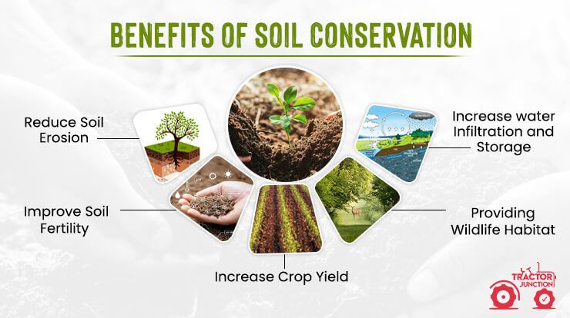
5. River Valleys
Threats: Dams, pollution, overuse of water
Conservation Methods:
  Riverbank afforestation
  Pollution control measures
  Watershed management

Slide 17
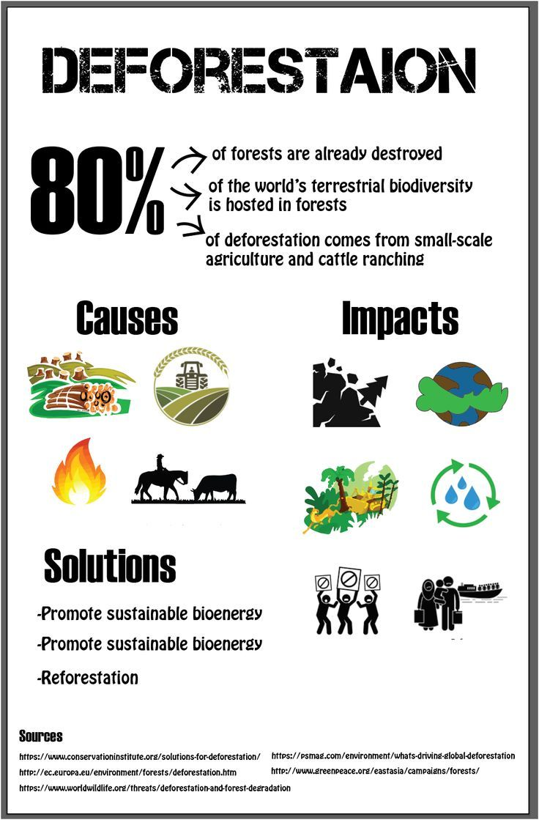
Deforestation: Deforestation or forest clearance is the removal and destruction of a forest or stand of trees from land that is then converted to non-forest use.
Deforestation can involve conversion of forest land to farms, ranches, or urban use.

Slide 18
Effect of land use changes:
Land use and land cover changes have significant environmental consequences at local, regional, and global scales.
These changes have intense implications at the regional and global scales for global loss of biodiversity, distresses in hydrological cycles, increase in soil erosion, and sediment loads.
“Land use” is the term used to describe the human use of land. It represents the economic and cultural activities (e.g., agricultural, residential, industrial, mining, and recreational uses) that are practiced at a given place.
Public and private lands frequently represent very different uses. For example, urban development seldom occurs on publicly owned lands (e.g., parks, wilderness areas), while privately owned lands are infrequently protected for wilderness uses.

Slide 19
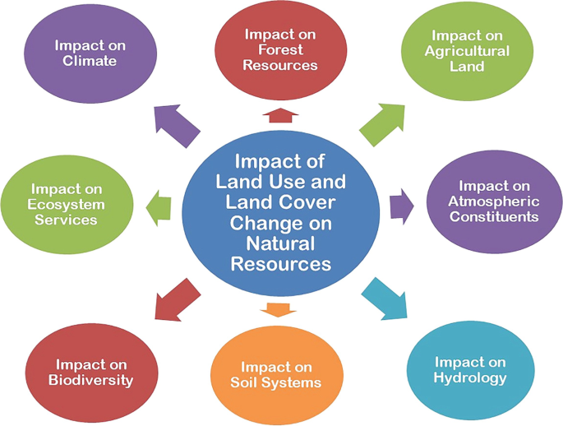

Slide 20
Land Development
Impervious surfaces: Land development creates impervious surfaces through construction of roads, parking lots, and other structures.
Contribute to nonpoint source water pollution by limiting the capacity of soils to filter runoff.
Affect peak flow and water volume, which heighten erosion potential and affect habitat and water quality.
Increase storm water runoff, which can deliver more pollutants to water bodies that residents may rely on for drinking and recreation.
Storm runoff from urban and suburban areas contains dirt, oils from road surfaces, nutrients from fertilizers, and various toxic compounds.
Affect ground water aquifer recharge.

Slide 21
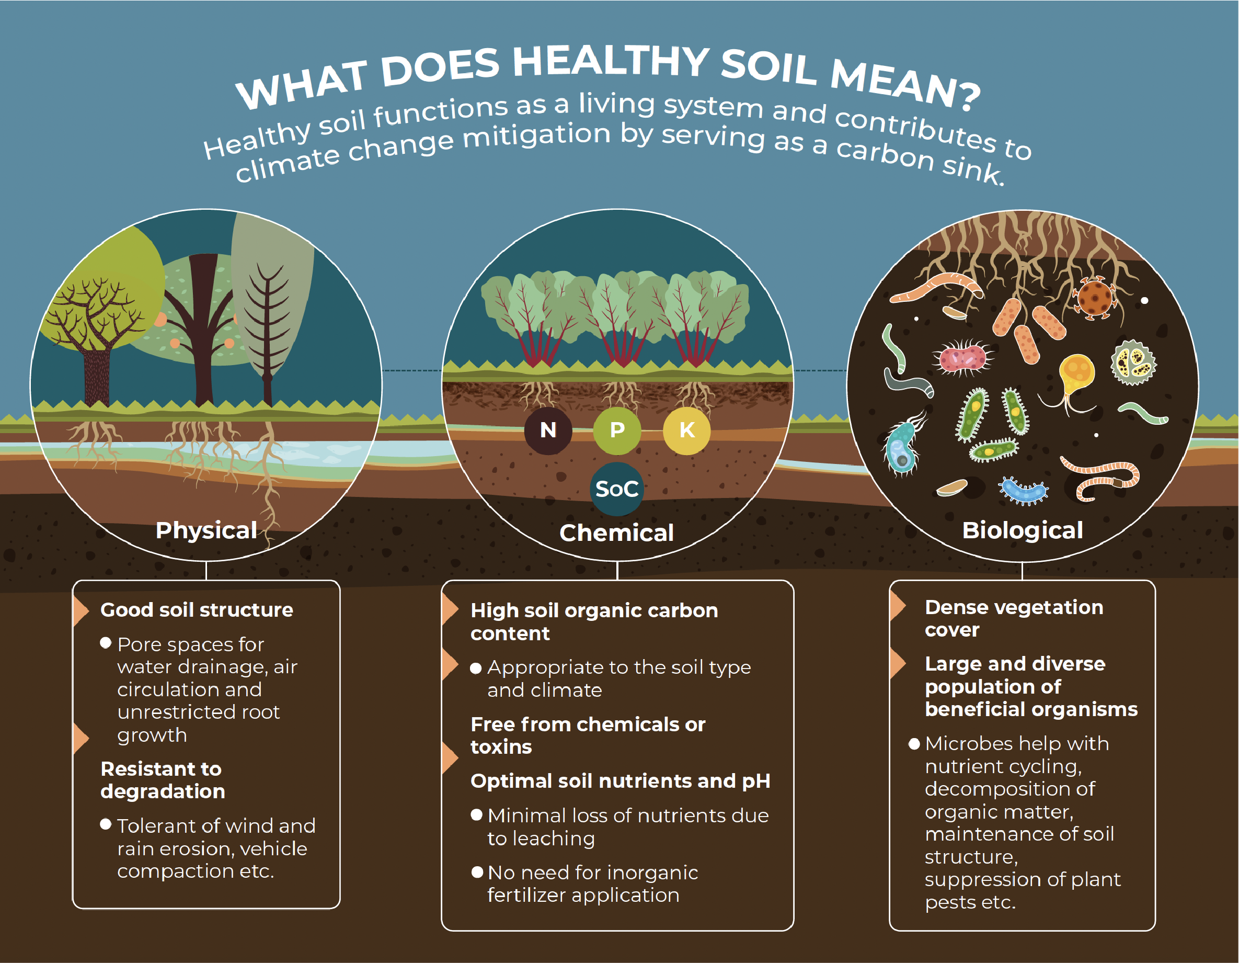
SOIL HEALTH:
Soil is not an inert growing medium – it is a living and life-giving natural resource.
It is teaming with billions of bacteria, fungi, and other microbes that are the foundation of an elegant symbiotic ecosystem.

Slide 22
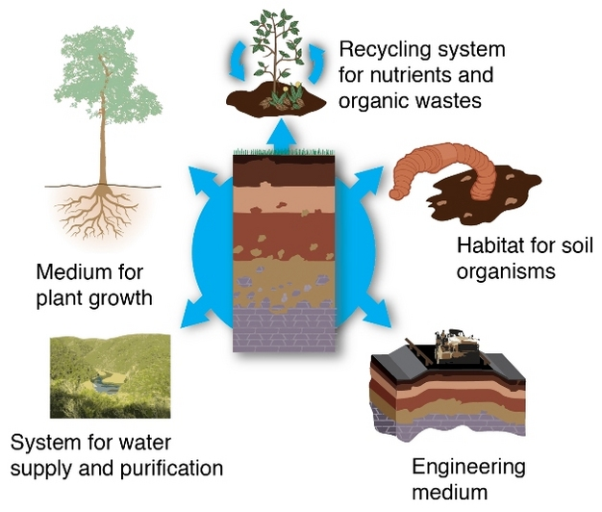
Soil health is defined as the continued capacity of soil to function as a vital living ecosystem that sustains plants, animals, and humans.
Healthy soil gives us clean air and water, bountiful crops and forests, productive grazing lands, diverse wildlife, and beautiful landscapes.
Soil performing five essential functions:

Slide 23
Soil performing five essential functions.
Nutrient Cycling - Soil stores, moderates the release of, and cycles nutrients and other elements. During these biogeochemical processes, analogous to the water cycle, nutrients can be transformed into plant available forms, held in the soil, or even lost to air or water.
Water Relations - Soil can regulate the drainage, flow and storage of water and solutes, which includes nitrogen, phosphorus, pesticides, and other nutrients and compounds dissolved in the water. With proper functioning, soil partitions water for groundwater recharge and for use by plants and soil animals.
Biodiversity and Habitat - Soil supports the growth of a variety of plants, animals, and soil microorganisms, usually by providing a diverse physical, chemical, and biological habitat.
Filtering and Buffering - Soil acts as a filter to protect the quality of water, air, and other resources. Toxic compounds or excess nutrients can be degraded or otherwise made unavailable to plants and animals.
Physical Stability and Support - Soil has the ability to maintain its porous structure to allow passage of air and water, withstand erosive forces, and provide a medium for plant roots. Soils also provide anchoring support for human structures and protect archeological treasures.

Slide 24
Ecological Importance of Soil
Plant Growth & Food Chains
  Soil provides essential nutrients, water, and support for plants, which are the base of most terrestrial food chains.
Habitat for Organisms
  Millions of microorganisms, insects, and burrowing animals live in soil, contributing to biodiversity and ecological balance.
Water Filtration & Purification
  Soil acts as a natural filter, removing contaminants from water as it percolates through layers, replenishing groundwater with cleaner water.
Carbon Storage
  Soil stores vast amounts of carbon as organic matter, helping regulate atmospheric CO₂ levels and mitigate climate change.
Nutrient Cycling
  Soil organisms decompose organic matter, recycling nutrients like nitrogen and phosphorus, making them available to plants.
Erosion Control & Landscape Stability
  Vegetation anchored in soil prevents erosion, landslides, and desertification.

Slide 25
Economic Importance of Soil
Agriculture & Food Production
  Soil is the foundation of agriculture, supporting crop and livestock production, which feeds populations and drives economies.
Forestry
  Healthy soils support timber production, which contributes to building materials, paper, and other wood-based industries.
Construction & Infrastructure
  Soil properties affect the stability of buildings, roads, and infrastructure. It is also a source of raw materials like clay, sand, and gravel.
Pharmaceuticals & Bio products
  Soil microbes are a source of antibiotics (like streptomycin) and other valuable biochemicals.
Tourism & Recreation
  Fertile landscapes, forests, and green areas supported by healthy soil enhance ecotourism and recreational value.
Environmental Services
  Soil management can reduce the costs of water treatment, flood control, and land rehabilitation.

Slide 26
What is Soil Degradation?
Soil degradation is the decline in soil quality and productivity caused by natural or human-induced processes.
It means the soil is losing its ability to function properly — to support plant growth, store water, recycle nutrients, and sustain life.
Main Causes of Soil Degradation
Erosion – Removal of topsoil by wind or water.
Nutrient Depletion – Loss of essential nutrients due to over-farming or poor soil management.
Salinization – Build-up of salt in soil, often from over-irrigation with poor drainage.
Pollution – Contamination by industrial waste, pesticides, or chemicals.
Compaction – Soil becomes hard and dense, limiting air, water, and root growth.
Deforestation – Tree removal exposes soil to erosion and nutrient loss.

Slide 27
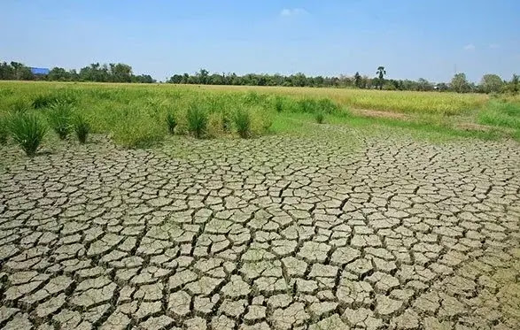
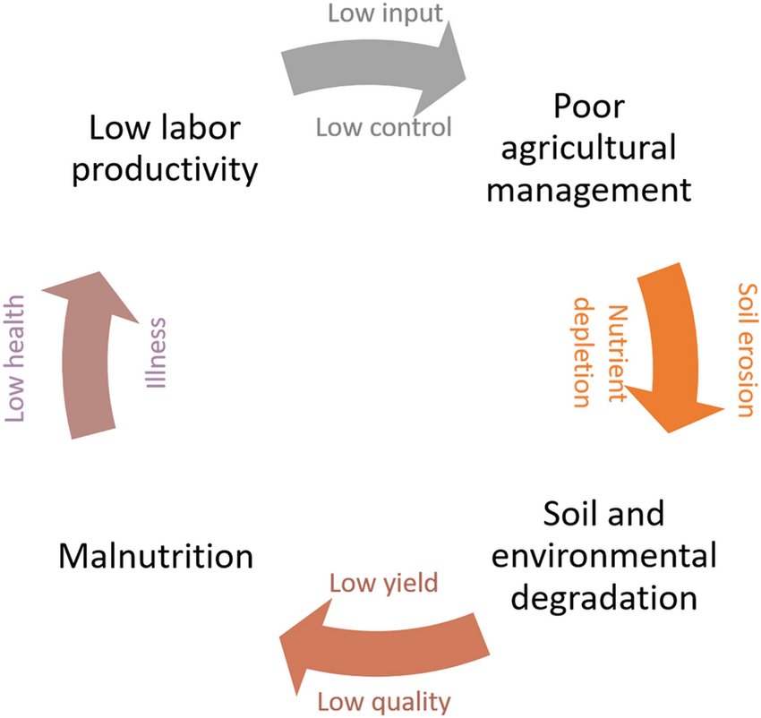
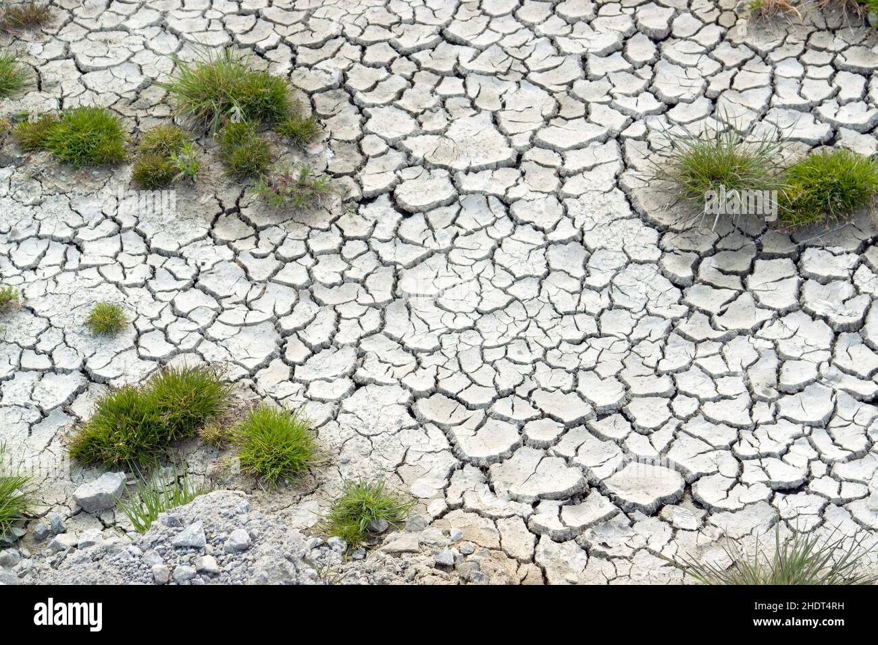
Fig: soil degradation
Fig: soil Nutrient Depletion
Fig: Drought and aridity

Slide 28
Fatal Effects of Soil Degradation
Land degradation : Soil quality decline is one of the main causes of land degradation and is considered to be responsible for 84% of the ever-diminishing acreage. Year after year, huge acres of land lost due to soil erosion, contamination, and pollution.
About 40% of the world’s agricultural land is severely diminished in quality because of erosion and the use of chemical fertilizers, which prevent the land from regenerating.
The decline in soil quality as a result of agricultural chemical fertilizers also further leads to water and land pollution thereby lowering the land’s worth on earth.
Drought and aridity: Drought and aridity are problems highly influenced and amplified by soil degradation.
As much as it’s a concern associated with natural environments in arid and semi-arid areas, the UN recognizes the fact that drought and aridity are anthropogenic induced factors especially as an outcome of soil degradation.

Slide 29
Loss of arable land Because soil degradation contributes to land degradation, it also means that it creates a significant loss of arable land.
As stated earlier, about 40% of the world’s agricultural land is lost on the account of soil quality depreciation caused by agrochemicals and soil erosion.
Most of the crop production practices result in the topsoil loss and the damage of soil’s natural composition that makes agriculture possible.
Increased flooding The land is commonly altered from its natural landscape when it rids its physical composition from soil degradation. For this reason, the transformed land is unable to soak up water, making flooding more frequent.
In other words, soil degradation takes away the soil’s natural capability of holding water thus contributing to more and more cases of flooding.

Slide 30
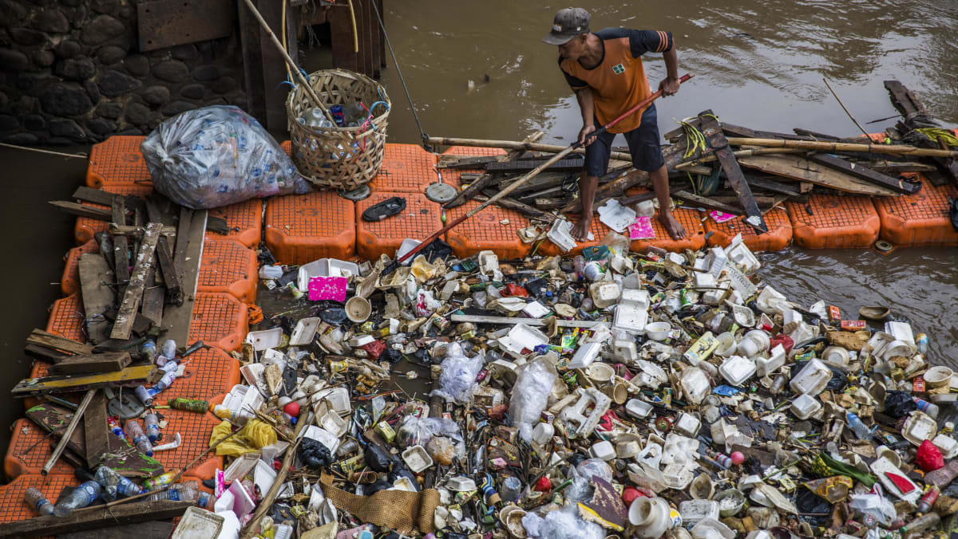
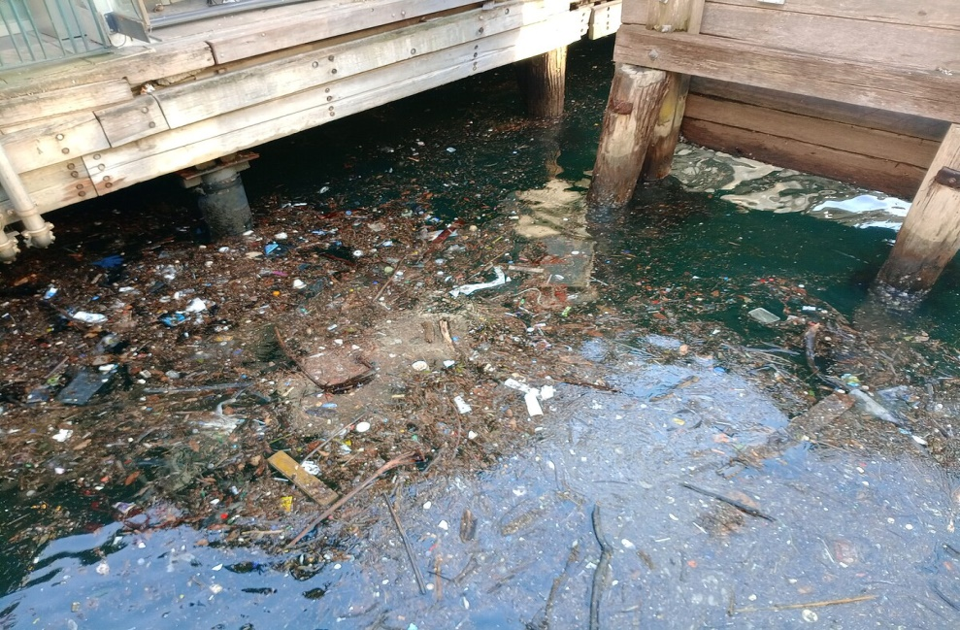
Pollution and clogging of waterways
Most of the soil eroded from the land together with the chemical fertilizers and pesticides utilized in agricultural fields are discharged into waterways and streams. With time, the sedimentation process can clog waterways, resulting in water scarcity.
The agricultural fertilizers and pesticides also damage marine and freshwater ecosystems and limit the domestic uses of the water for the populations that depend on them for survival.

Slide 31
Need for Soil Conservation
Soil conservation is essential because soil is a non-renewable resource on a human timescale — it takes hundreds to thousands of years to form just a few centimeters of healthy topsoil.
1. To Maintain Agricultural Productivity
Healthy soil is the foundation of farming.
Conserving soil ensures long-term food production by preserving nutrients and structure needed for crop growth.
2. To Prevent Land Degradation
Without conservation, soil is easily eroded, compacted, or polluted, leading to unproductive land and desertification.

Slide 32
3. To Ensure Food Security
A growing population needs more food — which depends on fertile soil.
Conserved soil supports reliable harvests, helping reduce hunger and malnutrition.
4. To Protect Water Resources
Soil filters and stores water.
Conserving it reduces runoff and pollution in rivers, lakes, and groundwater.
5. To Combat Climate Change
Soil stores large amounts of carbon.
Proper soil management helps reduce greenhouse gases and enhances carbon sequestration.
6. To Preserve Biodiversity
Soil hosts millions of organisms essential for ecosystem health.
Conservation protects these life forms and the ecological services they provide.

Slide 33
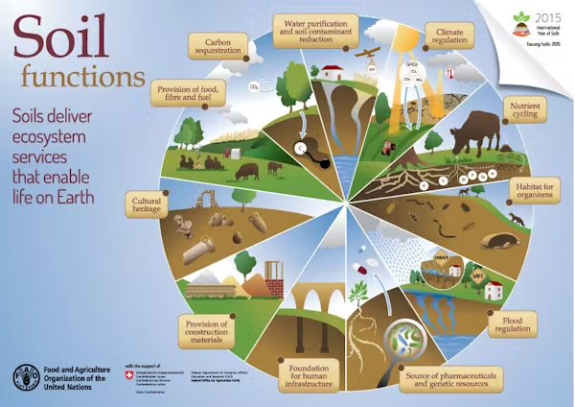
ECOLOGICAL AND ECONOMIC IMPORTANCE OF SOIL
Soil provides ecosystem services critical for life: soil acts as a water filter and a growing medium; provides habitat for billions of organisms, contributing to biodiversity; and supplies most of the antibiotics used to fight diseases.
Humans use soil as a holding facility for solid waste, filter for wastewater, and foundation for our cities and towns.

Slide 34
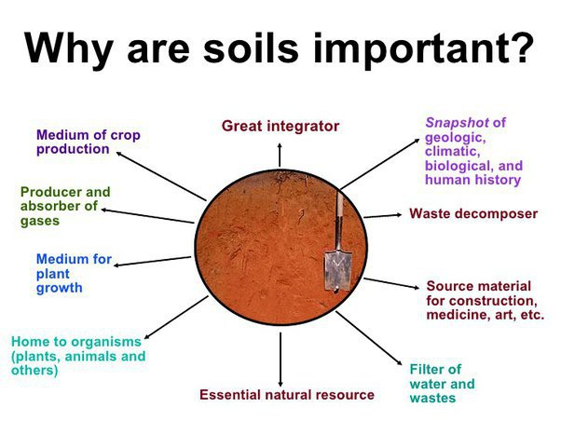

Slide 35
Ecological Importance of Soil:
Supports Plant Growth
Provides nutrients, water, and physical support for plants.
Essential for agriculture, forests, and natural vegetation.
Habitat for Organisms
Home to billions of microorganisms, insects, fungi, and small animals.
These organisms help decompose organic matter and recycle nutrients.
Nutrient Cycling
Plays a key role in the biogeochemical cycles (carbon, nitrogen, phosphorus).
Stores and releases nutrients needed for plant and microbial life.
Water Regulation
Filters, stores, and distributes water in the environment.
Reduces flooding and helps recharge groundwater.
Climate Regulation
Stores large amounts of carbon (more than the atmosphere and vegetation combined).
Helps mitigate climate change by sequestering CO₂.

Slide 36
Economic Importance of Soil
Agricultural Productivity
  Basis for farming and food production.
  Fertile soil is vital for crop yields, livestock feed, and overall food security.
Forestry and Timber Industry
  Healthy soils support forest ecosystems, which provide wood and other resources.
Construction and Infrastructure
  Soil is used as a foundation for buildings, roads, and other infrastructure.
  Its properties determine construction suitability and cost.
Raw Materials
  Source of materials like clay, sand, gravel, and minerals used in manufacturing.
Water Supply
  Helps maintain clean water supplies by filtering pollutants and recharging aquifers.

Slide 37
Ecological Importance of Soil
Advantages:
Supports Plant Life:
  Provides nutrients, water, and structure for plants to grow.
Biodiversity:
  Hosts diverse organisms (bacteria, fungi, insects) vital for nutrient cycling.
Water Filtration & Storage:
  Filters pollutants and stores water for ecosystems.
Carbon Storage:
  Sequesters carbon, helping to reduce greenhouse gases.
Erosion Control:
  Anchors plant roots, preventing erosion and land degradation.
Disadvantages:
Vulnerability to Degradation:
  Easily damaged by deforestation, overgrazing, and unsustainable farming.
Pollution Accumulation:
  Can absorb and store harmful pollutants (pesticides, heavy metals), affecting ecosystems.
Limited Regeneration:
  Natural soil formation is slow; recovery from damage can take decades or centuries.

Slide 38
Economic Importance of Soil
Advantages:
Foundation of Agriculture:
  Essential for food, fiber, and fuel production.
Source of Raw Materials:
  Provides sand, clay, and minerals for construction and manufacturing.
Water Resource Management:
  Helps regulate freshwater availability and quality.
Supports Industries:
  Forestry, construction, and pharmaceuticals depend on soil resources.
Disadvantages:
Productivity Decline from Misuse:
  Overuse, erosion, and salinization reduce long-term soil fertility.
High Restoration Costs:
  Rehabilitating degraded soil (e.g. through fertilizers, reforestation) is expensive.
Land Conflicts & Shortages:
  Fertile land is limited and can lead to competition or conflict over usage.

Slide 39
Impact of Soil Degradation on Agriculture
Soil degradation refers to the decline in soil quality due to factors such as erosion, salinization, nutrient depletion, pollution, and loss of organic matter. This has multiple negative effects on agricultural productivity:
Reduced Crop Yields
Degraded soils have lower fertility and less capacity to hold water and nutrients.
Crops grown in such soils produce smaller yields or fail entirely.
Loss of Arable Land
Severe degradation (like desertification) can render land completely unfit for farming.
This reduces the total available land for agricultural use.
Increased Dependency on Inputs
Farmers may need to use more fertilizers, pesticides, and irrigation to compensate for poor soil quality.
This increases production costs and can lead to further environmental harm.

Slide 40
Poor Soil Structure
Soil compaction and erosion destroy soil structure, affecting root growth and water infiltration.
This reduces plant health and increases vulnerability to drought and pests.
Impact on Food Security
Food security is defined as the availability, access, utilization, and stability of food. Soil degradation threatens all four pillars:
1. Availability
Decreased agricultural productivity leads to lower food production, threatening supply, especially in regions heavily reliant on agriculture.

Slide 41
2. Access
Lower yields can drive up food prices, making it harder for low-income populations to afford nutritious food.
3. Utilization
Nutrient-depleted soils grow less nutritious crops, affecting the quality of food and leading to deficiencies in human diets.
4. Stability
Soil degradation reduces the resilience of food systems to climate change, droughts, and other shocks, increasing the risk of food crises.
Examples and Global Context
Sub-Saharan Africa: Soil erosion and nutrient depletion have caused major drops in crop productivity, worsening hunger in already vulnerable communities.
South Asia: Overuse of chemical fertilizers has degraded soils, affecting long-term sustainability.
Latin America: Deforestation for agriculture has led to rapid erosion and reduced land fertility.

Slide 42
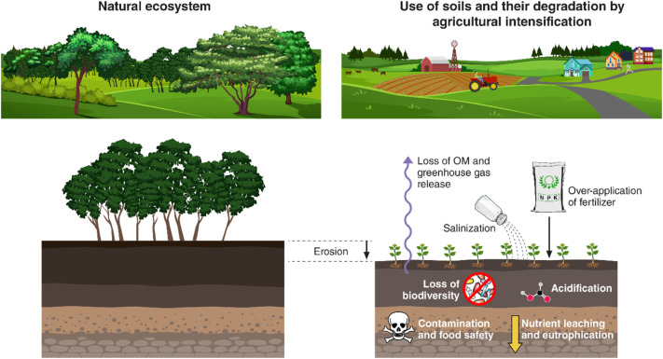
Solutions
Sustainable farming practices (e.g., crop rotation, conservation tillage)
Soil restoration and reforestation
Integrated nutrient management
Education and policy reforms supporting soil health

Slide 43
Need for Soil Conservation
Why Soil Conservation is Important
1. Supports Agricultural Productivity
Healthy soil is essential for growing crops and maintaining high yields.
Soil conservation maintains fertility, structure, and moisture—key factors for plant growth.
2. Ensures Food Security
Conserved soil leads to stable and sustainable food production.
Prevents loss of arable land, reducing the risk of hunger and malnutrition.
3. Prevents Land Degradation and Desertification
Soil erosion and nutrient loss can turn fertile land into barren deserts.
Conservation helps protect against irreversible land degradation.

Slide 44
4. Combats Climate Change
Soils store large amounts of carbon. When degraded, they release CO₂.
Healthy soils act as carbon sinks, helping to mitigate global warming.
5. Protects Water Resources
Soil filters and stores water, reducing runoff and pollution.
Conservation practices improve water infiltration and reduce flooding and sedimentation in rivers.
6. Preserves Biodiversity
Soil is home to billions of organisms that maintain ecological balance.
Conserving soil protects this underground biodiversity, essential for nutrient cycling and plant health.

Slide 45
Soil Conservation Practices
Contour plowing and terracing – to prevent erosion on slopes.
Cover cropping and crop rotation – to maintain soil fertility.
Agroforestry and afforestation – to protect soil from wind and water erosion.
Organic farming – to improve soil structure and microbial health.
Reduced chemical use – to prevent contamination and maintain natural soil composition.

Slide 46
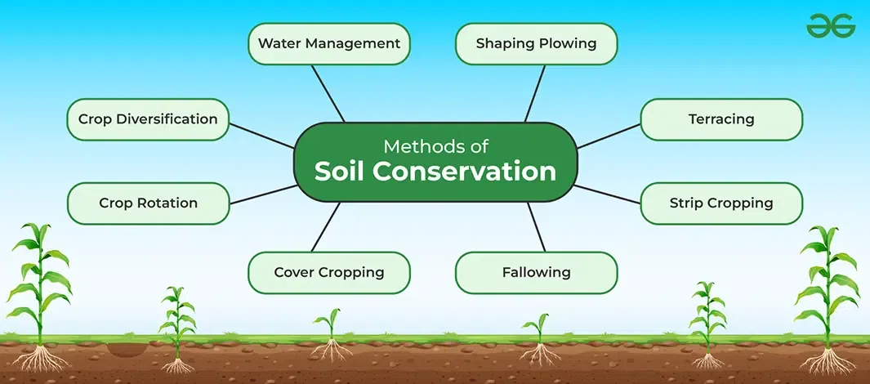

Slide 47
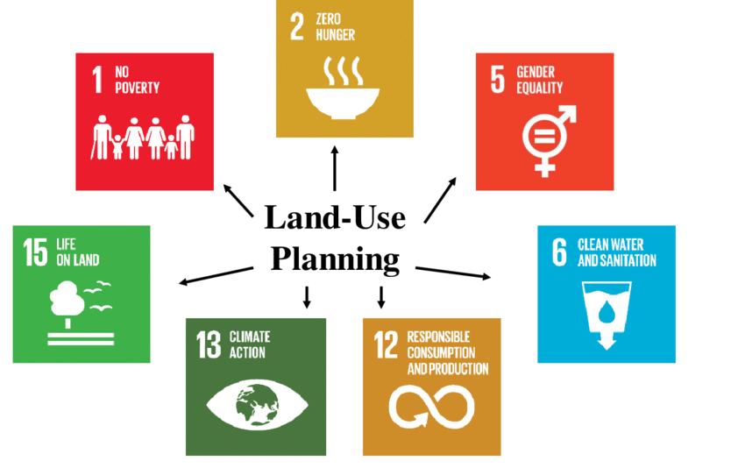
Sustainable Land Use Planning is a strategic approach to managing land resources in a way that balances environmental, social, and economic needs—both for present and future generations.
It aims to use land efficiently, minimize environmental impact, and support sustainable development.

Slide 48
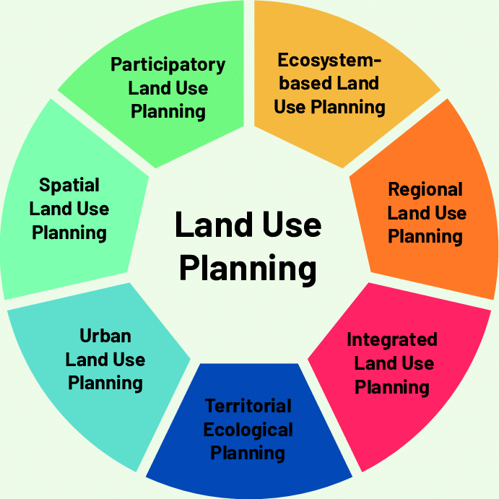

Slide 49
Principles of Sustainable Land Use Planning
Environmental Protection
  Preserve natural habitats, biodiversity, and ecosystems
  Prevent land degradation and pollution
  Protect water resources and soil health
Social Equity
  Ensure access to land and resources for all communities
  Promote inclusive participation in planning processes
  Protect cultural heritage and indigenous rights
Economic Viability
  Support productive use of land (agriculture, forestry, etc.)
  Encourage sustainable urban development
  Promote local economic development and job creation

Slide 50
Integrated Planning
  Coordinate land use with transportation, energy, and water systems
  Plan at multiple scales—local, regional, national
  Align with climate change mitigation and adaptation strategies
Resilience and Adaptability
  Incorporate risk management for natural disasters and climate change
  Promote adaptive reuse and circular economy principles
  Support long-term monitoring and flexible policies

Slide 51
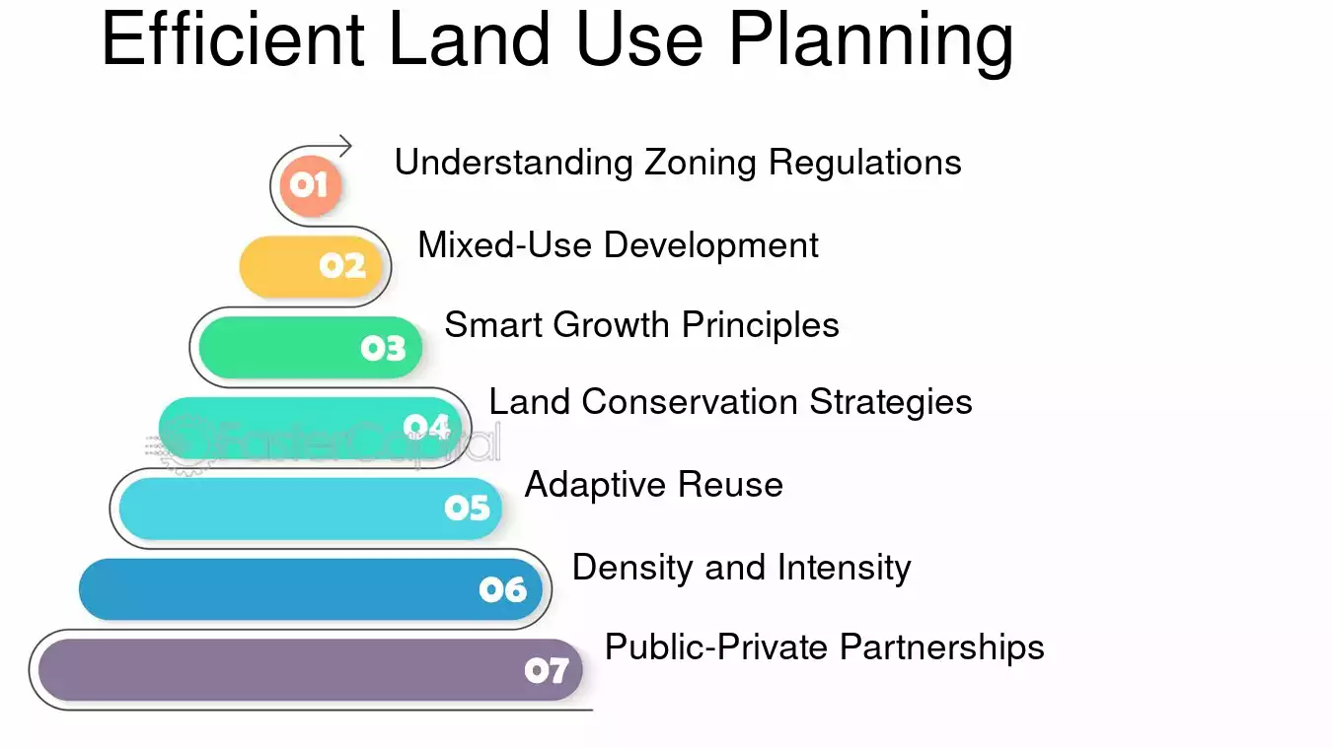
Tools & Techniques Used
Zoning Regulations
Geographic Information Systems (GIS)
Environmental Impact Assessments (EIA)
Participatory Planning Workshops
Urban Growth Boundaries
Carrying Capacity Analysis

Slide 52
Practice | Description
Smart Growth | Compact, transit-oriented urban design to reduce sprawl
Agroforestry | Integrating trees into agricultural land to enhance productivity and biodiversity
Green Infrastructure | Using natural systems (like wetlands) to manage stormwater and reduce heat
Land Restoration | Rehabilitating degraded land for agriculture or conservation
Mixed-Use Development | Combining residential, commercial, and recreational land uses

Slide 53
Benefits
Reduced greenhouse gas emissions
Enhanced food and water security
Improved public health and quality of life
Economic opportunities and sustainable livelihoods
Preservation of natural and cultural heritage

Slide 54


